Slide 1
AC4.1 Describe food related causes of ill health
What is meant by the food intolerance?
___________________________________________________________________________________________________________________________
What is meant by food allergen?
___________________________________________________________________________________________________________________________
Revision
Question mat
What bacteria need to multiply
Complete table about how different contamination can cause ill health.
Contamination | Give 3 examples of where it can be found. | Effect on Health
Metals
Chemical
Poisonous plants
Parasites
Physical Contamination
Explain the difference between pathogenic bacteria and Spoilage bacteria?
____________________________________________________________________________________________________________________________________________________________________________________________________________________________________________________________________________________________________________________________________________________________________________________________________________________________________________________________________________________________________________________________________________________________________________________________________________________________________________________________________________________________________________________________
Summarise how the two food intolerance cause ill health. What is the cause? What are the problem ingredients? What food can not be eaten?
____________________________________________________________________________________________________________________________________________________________________________________________________________________________________________________________________________________________________________________________________________________________________________________________________________________________________________________________________________________________________________________________________
____________________________________________________________________________________________________________________________________________________________________________________________________________________________________________________________________________________________________________________________________________________________________________________________________________________________________________________________________________________________________________________________________
Identify 15 main allergenic foods
Coeliac disease
Lactose intolerance

Slide 2
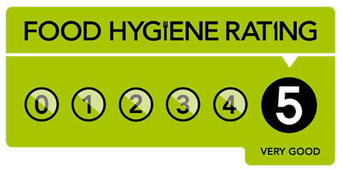
AC4.2 Describe the role and responsibilities of the EHO
What does EHO Stand for?
___________________________________________________________________________________________________________________________
What is the role of an EHO?
___________________________________________________________________________________________________________________________
Revision
Question mat
Explain how the food hygiene rating works?
Below are legislation that are enforced by an EHO – Briefly explain what these law are.
Legislation | Description
The Food Safety Act
The General food hygiene regulations
The temperature control regulations
The food composition regulations
____________________________________________________________________________________________________________________________________________________________________________________________________________________________________________________________________________________________________________________________________________________________________________________________________________________________________________________________________________________________________________________________________
Explain how an EHO would investigate an outbreak of food poisoning
____________________________________________________________________________________________________________________________________________________________________________________________ _____________________________________________________________________________________________________________________________________________________________________________________________ ____________________________________________________________________________________________________________________________________________________________________________________________________________________________________________________________________________________________________________________________________________________________________________________________________________________________________________________________________________________________________________________________________________________________________________________________________________________________________________________
Public Health
laboratory
What are the consequences of poor inspection results?
Swabs?
Work with who?
Report?

Slide 3
AC4.3 Describe food safety Legislation
Food Safety Act 1990 – What it all about ? ________________________________________________________________________________________________________________________________________________________________________________________________________________________________________________________________________
Revision
Question mat
H A C C P
HACCP (2006)
_____
Complete the mind map on food safety legislation:
What is the point of HACCP (2006)?
__________________________________________________________________________________________________________________________________________________________________________________________________________________________________________________________________________________________________________________________________________________
_____
Food premises
Personal hygiene of staff
_____
Food safety legislation cover three main areas:
_____
Hygienic practices
_____
Identify the information that is required on food packaging on the label below?

Slide 4
AC4.4 Describe common types of food poisoning.
Revision
Question mat
Fill the germ with all your knowledge on food poisoning bacteria. Include symptoms, sources of food.
Create a rap/song/poem to help your remember food poisoning bacteria.
________________________________________________________________________________________________________________________________________________________________________________________________________________________________________________________________________________________________________________________________________________________________________________________________________________________________________________________________________________________________________________________________________________________________________________________________________________________________________________________________________________________________________________________________________________________________________________________________________________________________________________________________________________________________________________________________________________________________________________________________________________________________________________________________________________________________________________________________________________________________________________________________________________________________________________________________________________________________________________________________________________________________________________________________________________________________________________________________________________________________________________________________________________________________________________________________________________________________________________________________________________________________________________________________________________________________________________________________________________________________________________________________________________________________
Use different colours for different bacteria.

Slide 5
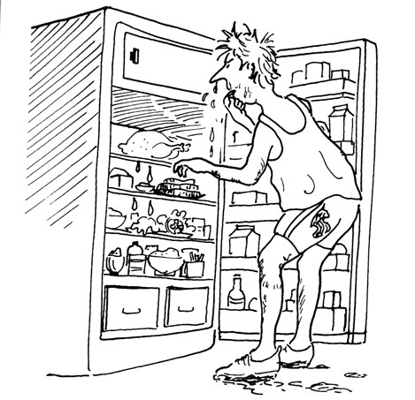
AC4.4/4.5 Describe the symptoms of food induced ill health.
Explain how you can identify if ill health has been caused by an allergen, food poisoning or food intolerance?
Revision
Question mat
________________________________________________________________________________________________________________________________________________________________________________________________________________________________________________________________________________________________________________________________________________________________________________________________________________________________________________________________________________________________________________________________________________________________________________________________________________________________________________________________________________________________
How can you stop food poisoning by the following:
Storing food
The kitchen
Personal hygiene
Serving food
Cooking and cooling
Draw some of the symptoms you could have if food has caused ill health. Label if symptom is caused by poisoning, intolerance or allergy.
Symptoms
Explain how should you store food in the fridge?
________________________________________________________________________________________________________________________________________________________________________________________________________________________________________________________________________________________________________________________________________________________________________________________________________________________________________________________________________________________________________________________________________________________________________________________________________________________________________________________________________________________________
What should you do if someone goes into anaphylaxis?
_______________________________________________________________________________________________________________________________________________________________________________________________________________________________________________________________________________________________________________________________________________________________________________________________________________________________________________________________________________________________________________________________________________________________________________________________________________________________________________________________________________________________

