Slide 1
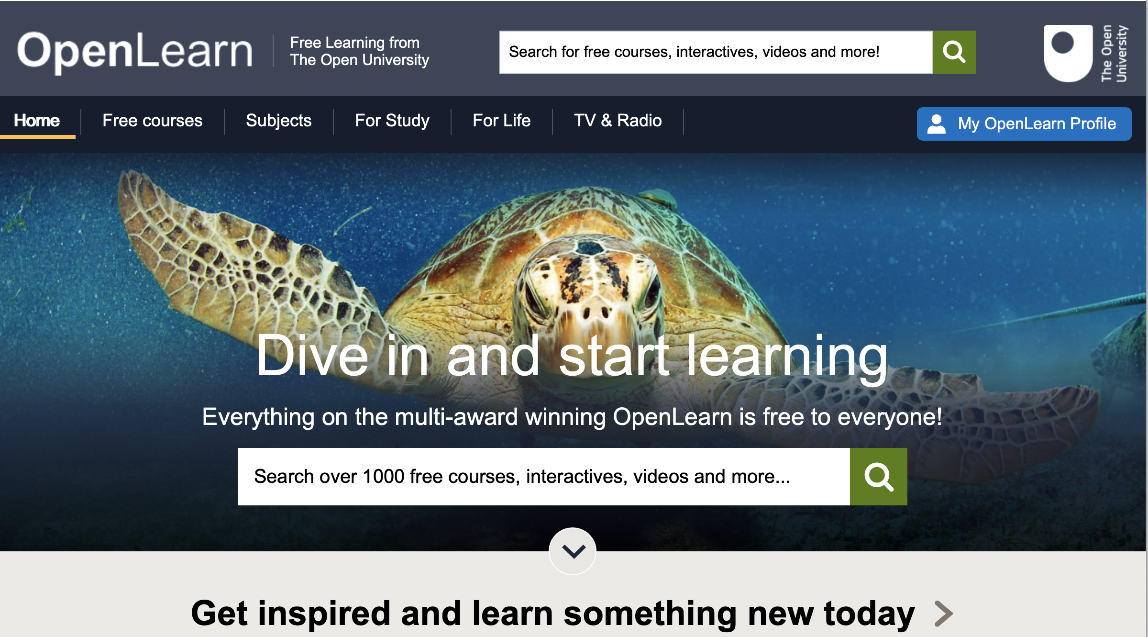
Open University: Open Learn

Slide 2
What’s the Open University?
We are the leading university for flexible, innovative teaching and world-leading research in the United Kingdom and in 157 countries worldwide. Uniquely placed to understand the needs of part-time students, combining their learning while earning, our innovative, award-winning distance teaching credentials have seen over 2 million students receive an education.

Slide 3
Why do it?
Take an interest in a subject you enjoy and want to know more about
Learn something new e.g. psychology, Chinese, music, Latin and Greek, infection and immunity, social psychology and politics, earthquakes, digital forensics (list is endless)
Shows you have a commitment to learning and your future career pathway in this ‘unusual territory’
Provides evidence for your A level and college interviews
Develop your skills-set
Independence and wider reading

Slide 4
What do I get at the end of it?
Awarded Statement of Participation

Slide 5
Step 1 – Create an account

Slide 6
Step 2 – Click ‘free courses’ to browse the subjects (1000 to choose from)

Slide 7
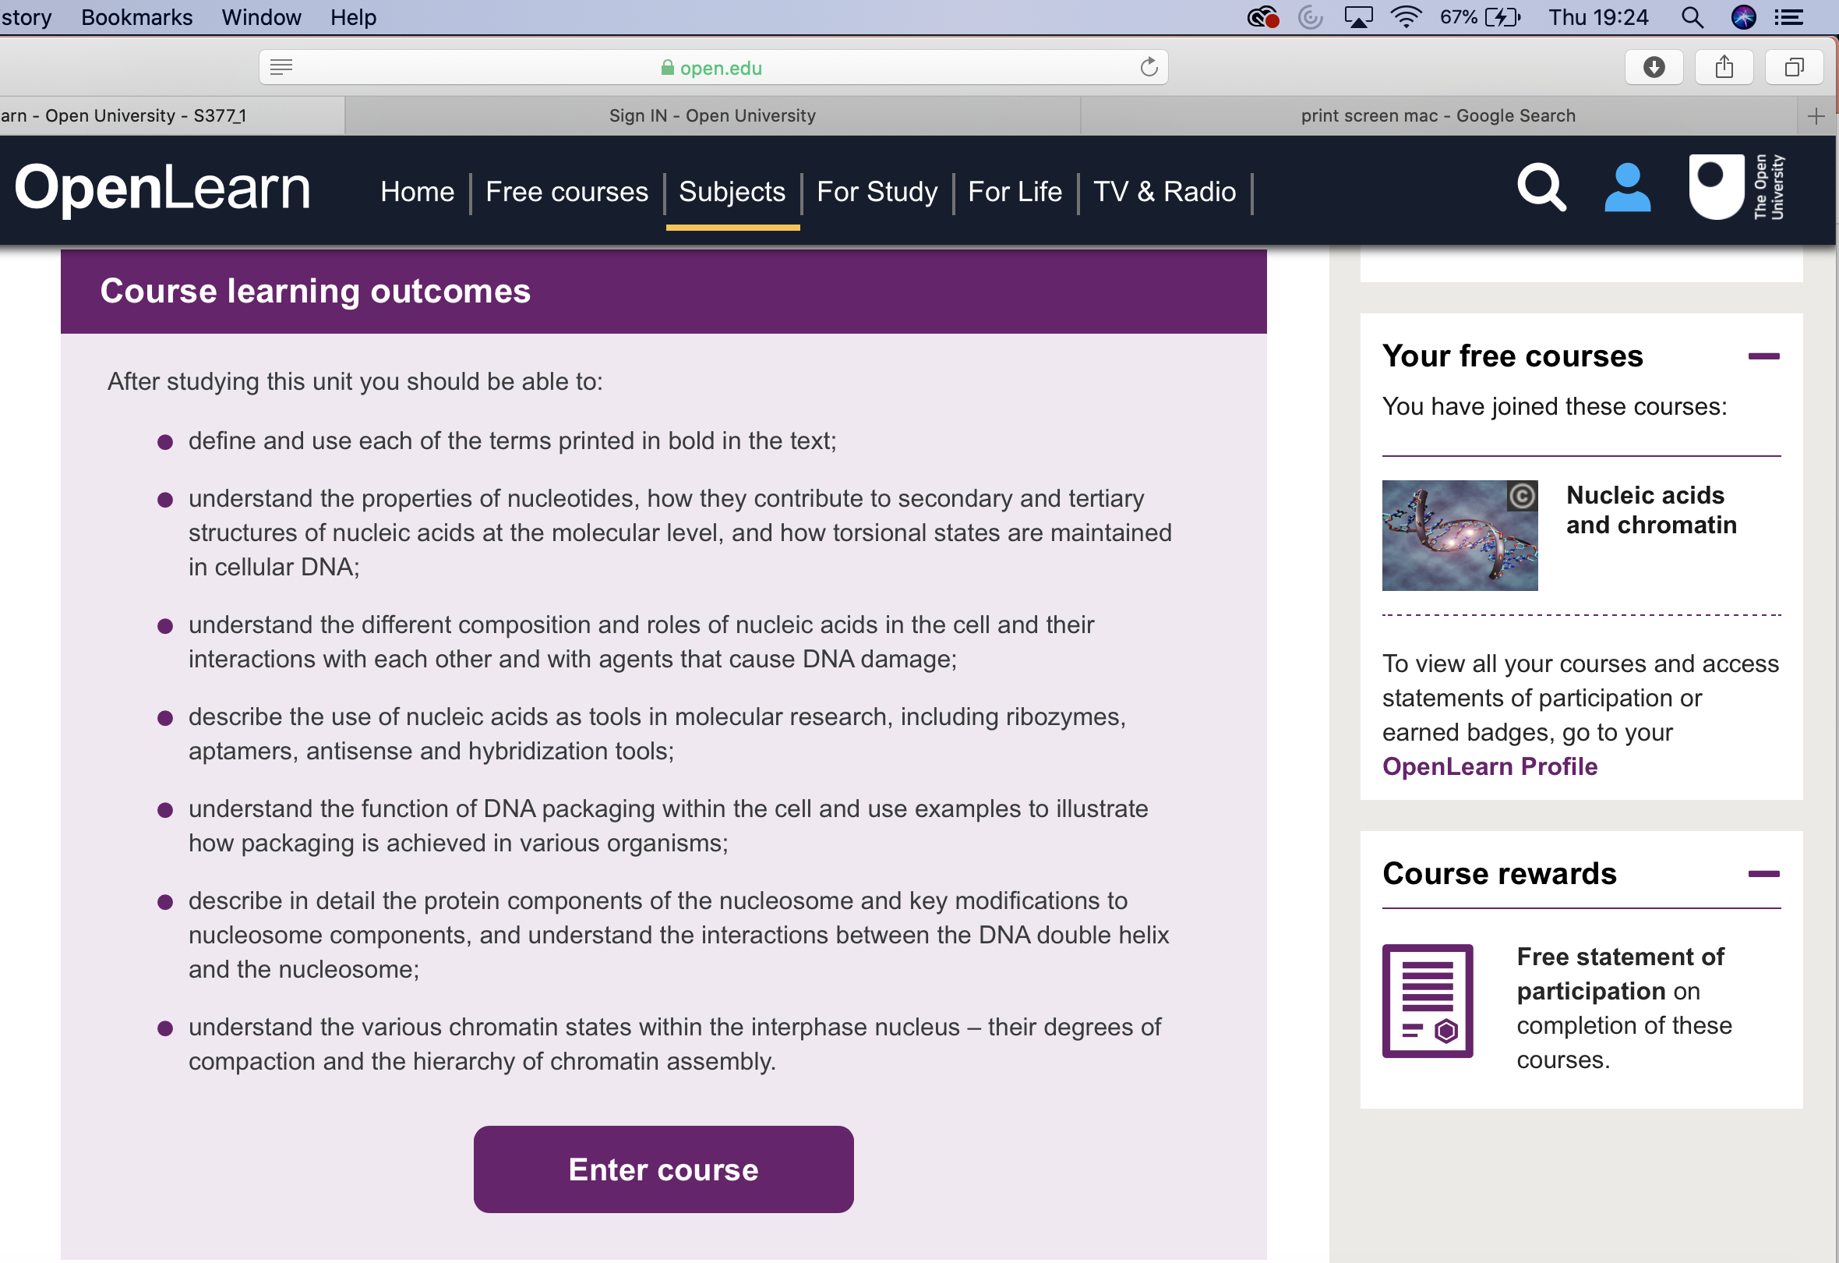
Step 4 – Click ‘Enrol now’, scroll down and ‘enter course’ to begin working through the content

Slide 8
Step 5 – Check your progress
Click here first
Then here

Slide 9
Step 6 – Issued with ‘statement of participation’
Send your certificate to sema@riverside.bardaglea.org.uk
You will then receive a printed copy in the post for you to keep and use as evidence for continued learning
On completion receive your certificate

Slide 10
Step 7 – Select another course and widen your knowledge further

