Slide 1
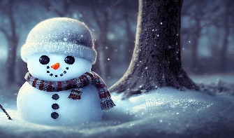
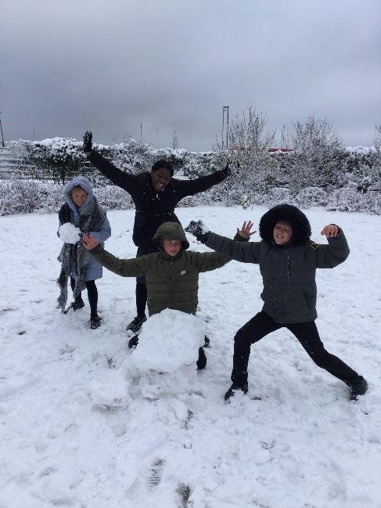
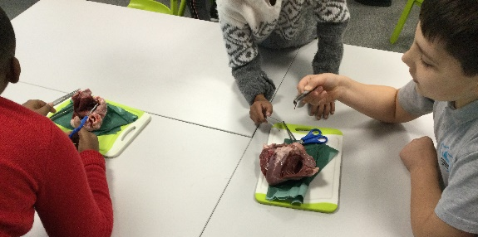
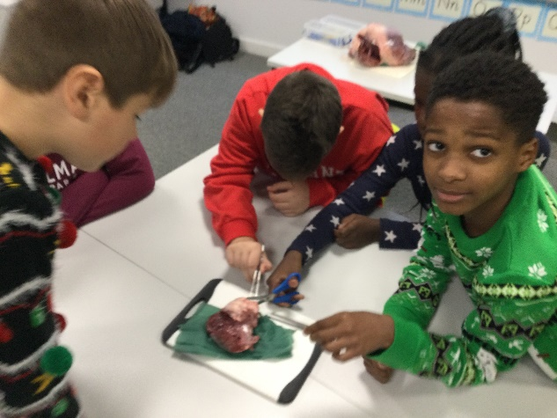
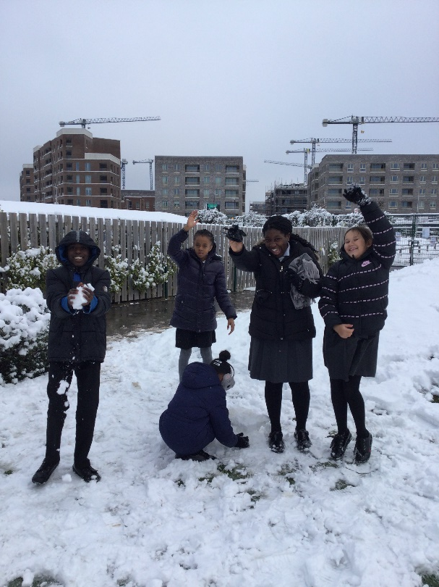
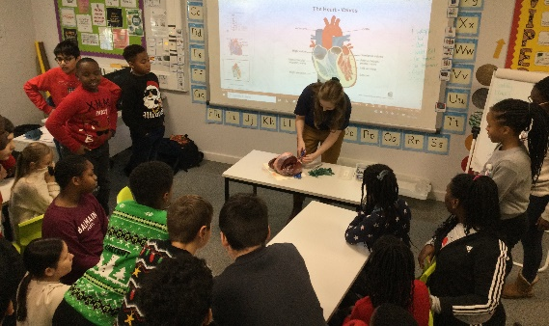
We also enjoyed the wonderful snow!
In Science, we have been learning
about the circulatory system.
Here are some pictures of when we dissected a heart!
In December, we held
our KS2 Christmas
Carol performance.
We really enjoyed singing
‘Rocking around the Christmas Tree’.
We also enjoyed
a delicious
Christmas dinner!
December

