Slide 1
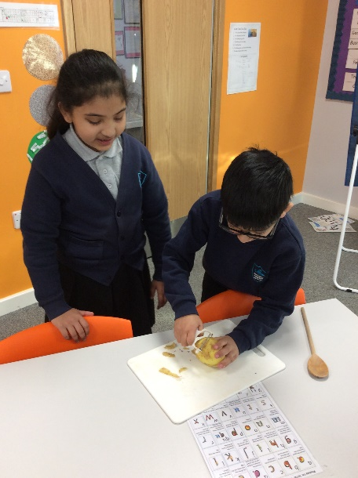
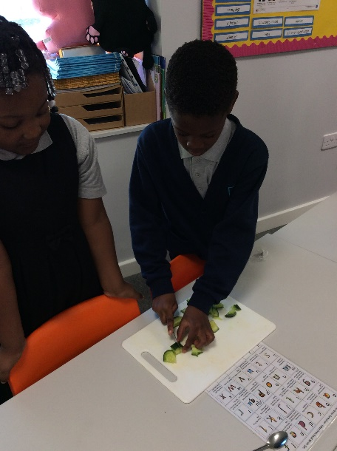
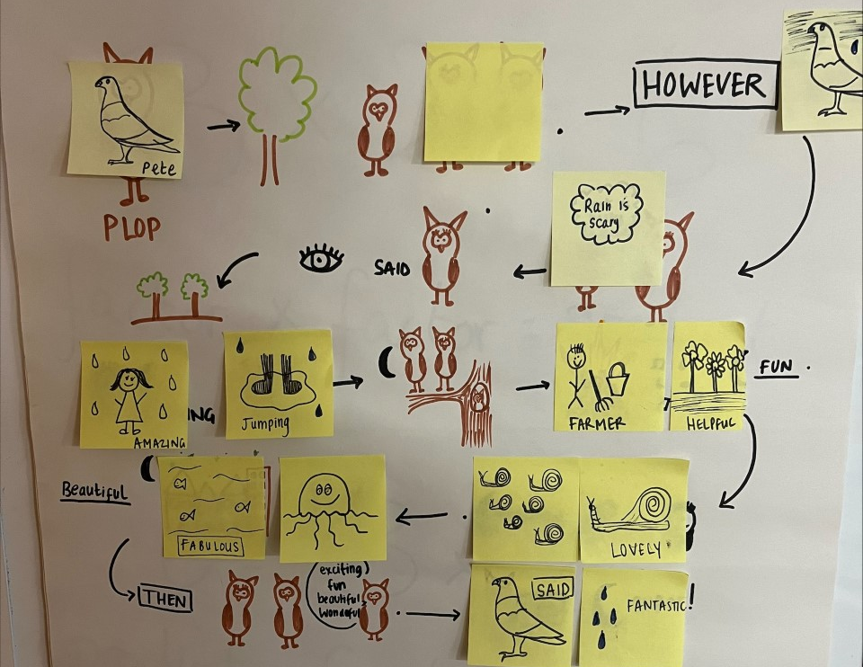
This month we learnt about camouflage and habitats. Hands on Science came in and taught us how animals camouflage and why they do.
In December we got ready for Christmas by practicing our Nativity Performance. Then we have performed this to all of our parents, we hope you enjoyed it!
In Big Write we have used our Talk4Writing skills to build a story map of ‘The Owl Who Is Afraid Of The Dark’. We have then wrote our own story from this.
In Maths we have begun to multiply numbers. We have spent a lot of time looking at equal groups and how we can use repeated addition.
December

