Slide 1
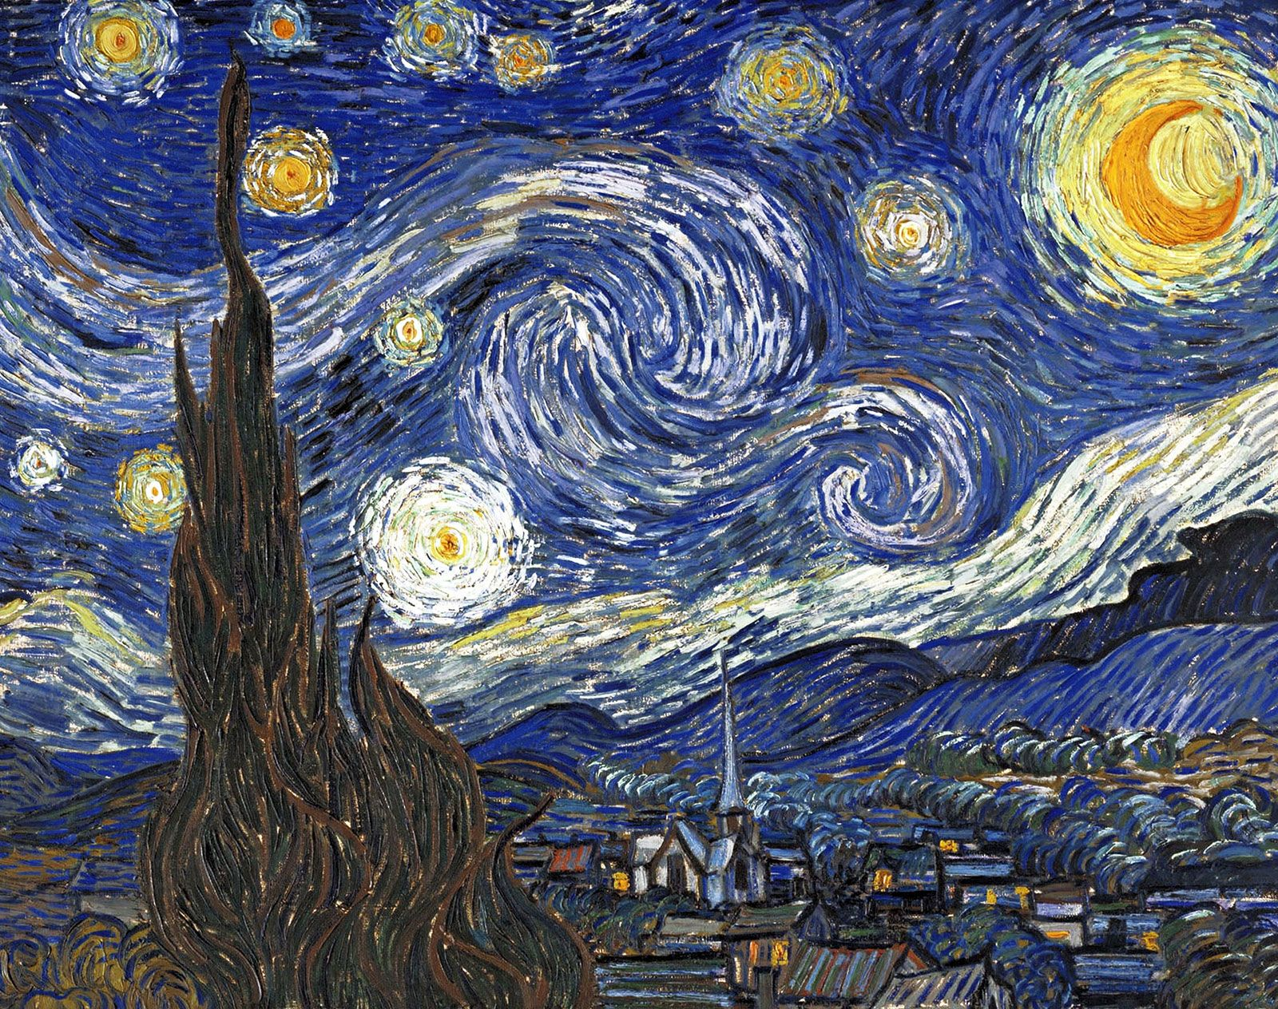
This half term, we have been looking at significant people for our topic, Movers and Shakers. Below are your homework projects. Please choose at least one to be completed and brought to school by Friday 13th January 2023.
Poster
We have been learning about many different activists this half term. Create a poster on one of these activists: Rosa Park, Emmeline Pankhurst, Martin Luther King or Malala.
Remember to include what they fought for, what was their impact and any other important information you remember/can find.
Human Survival
We have been learning about the basic needs of humans for survival, including the importance of exercise, nutrition and good hygiene. Can you create an information sheet about the importance of exercise, nutrition and hygiene for humans.
Significant People
Choose five famous people and find out about their impact on the world. Can you rank them from who you think is the most to the least significant?
Van Gogh
Using a range of materials, can you create a piece of artwork inspired by Vincent Van Gogh. Remember he uses bold colours and strong brush strokes to create his pieces of art.

