Slide 1
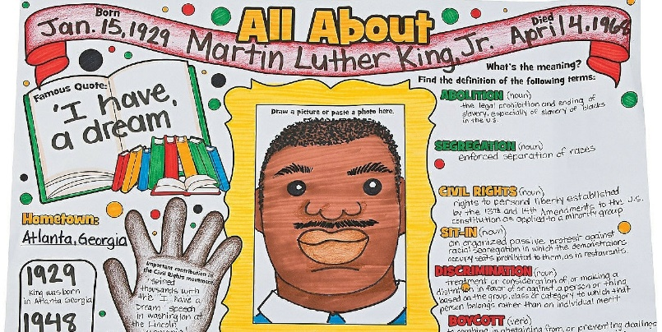
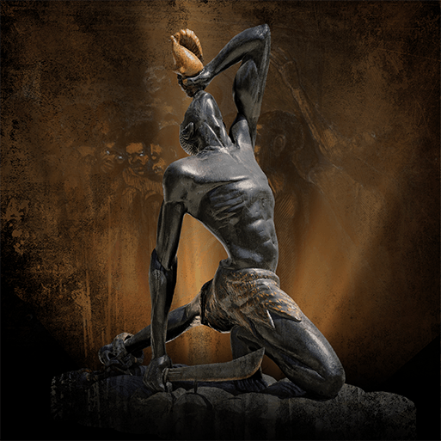
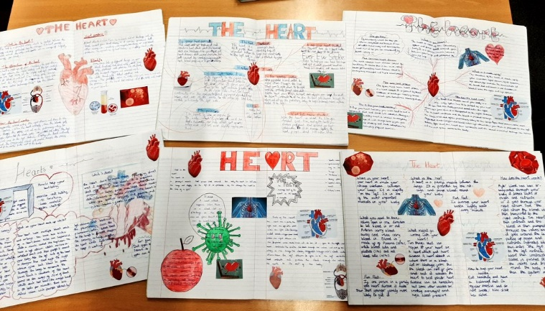
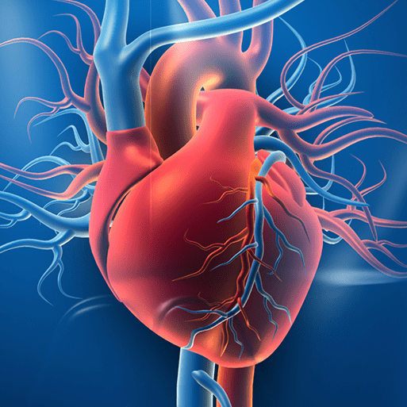
In Autumn, our topic was Maafa. Here are some home learning activities to consolidate and extend our learning. Please choose at least one activity to complete. Your project is due by Friday 13th January 2023.
Create an infographic about an aspect of your Maafa project, such as the slave
trade, middle passage, resistance and rebellion or abolition. Use your knowledge,
books and the internet to provide facts and figures and use images from the
Slavery Images website. Examples of infographics can be found online.
Write what you have learned about Africa today, Africa’s history, the slave trade, the events that led to the eventual abolition of slavery and the lives of black people in Britain.
View examples of art made by the skilled craftspeople in the ancient Kingdom of Benin on the British Museum’s website. Focus on one artefact that interests you. Sketch and name the artefact and describe what it is made from, when it was made, who made it, who owned it and any significant features.
In Science, we have been learning about the circulatory system. Create a poster, 3D model or drawing to show the main parts and primary functions of the human circulatory system.
You can also talk about healthy lifestyle choices and the effects of harmful substances on the body.
Maafa

