Slide 1
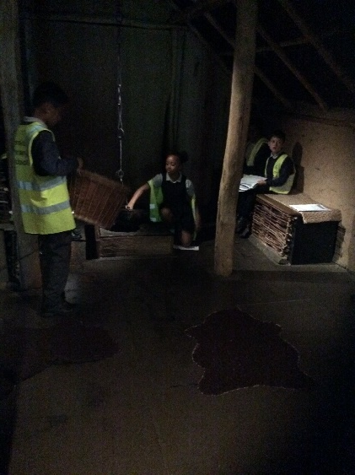
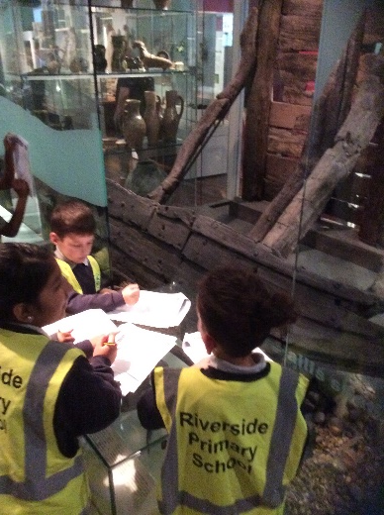
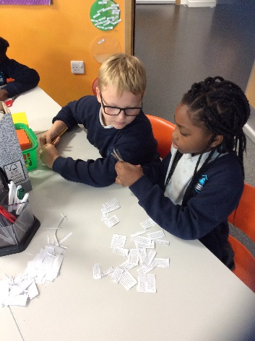
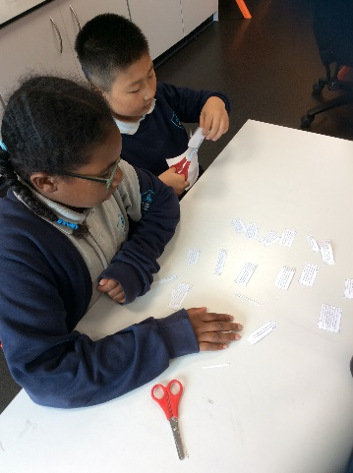
Big write:
We have been writing Anglo Saxon poetry using powerful adjectives and kennings.
We have written play scipts based around a dilemma.
We have written diary entries as Anglo Saxon farmers.
Year 4 Blog
September 2022
Religious Education
Topic: Religion inour Neighbourhood
We have learned about the evidence of different religions in our local area.
We have investigated the different places of worship within Barking.
We have learned about how our neighbourhood is different to other parts of the country.
We have learned about how religion in our local area has changed over time.
Reading: VIPERS
Texts: ‘There’s a Viking in my Bed’ and ‘Everything Vikings’.
We retrieved and recorded key information from a fiction text.
We found and explained the meaning of words in context.
We explained how content is related and contributes to the meaning as a whole.
We predicted what might happen from the details stated and implied.
We made inferences from the text by explaining and justifying answers.
Maths:
Number and Place Value
We have been exploring ones, tens, hundreds, thousands and how they make up numbers.
We have been using number lines to round to the nearest 10, 1000 and 1000.
We have been adding and subtracting using formal written methods.
History
We have learned all about why the Romans left Britain and what the consequences were.
We have investigated the invasions which followed the Roman withdrawal from Britain.
We have understood why the Anglo Saxons invaded and settled in Britain.
We have investigated the Viking invasion.
We have learned about the legacy of the Anglo Saxons in Britain.
As part of our topic, we visited the Museum of London and experienced what an Anglo Saxon house would have been like!

