Slide 1
Riverside Primary School
Year 6 Curriculum Map
Summer 2 - 2022

Slide 2
Topic Title: Maths
Maths:
We will focus on: Consolidation & themed projects
Small steps taken from White Rose Maths
White Rose Bakery:
Best value
Profit & loss
Packaging
Cooking problems
White Rose Futures:
Annual salary
Hourly rates
Bills
Mortgage
House

Slide 3
Topic Title: Literacy
Writing:
We will focus on:
Newspaper Report – About a virus infiltrating the school network
Play script – Little Red Riding Hood using Google maps to find Grandma’s house
Narrative (thriller story)
VIPERS:
We will be reading:
Pig Heart Boy
The Heart and the Bottle
Heroic Heart
Spelling rule: (KS2)
We will focus on:
Word families based on common words, showing how words are related in form and meaning
Words that can be nouns and verbs
Words with a long /o/ sound spelt ‘ou’ or ‘ow’
Words ending in –ibly

Slide 4
Topic Title: Wider Curriculum
PSHE: Relationships
We are learning about:
What is mental health?
My mental health
Love and loss
Power and control
Being online: Real or fake? Safe or unsafe?
Using technology responsibly
Music: Music and Me
We are learning to:
Listen and Appraise
2. Get to know the artists – inspirational women in the music industry
3. Create own music
4. Perform, share and present
R.E
We are learning about religious leaders.

Slide 5
Topic Title: Wider Curriculum
P.E: Striking/ Fielding Games
We are learning to:
• Consolidate passing, receiving, moving and dribbling to maintain possession.
• Consolidate defending and defensive tactics.
• Create, understand and apply attacking tactics in game situations.
• Create, understand and apply defending tactics in game situations.
• Consolidate attacking and defending in games.
• Develop officiating.
• Organise formations, decide tactics, manage teams and officiate games.
Computing: iProgram (unit 2)
We are learning to:
Design, write and debug programs
Use sequence, selection and repetition in programs
Use logical reasoning to explain how some simple algorithms work
Understand computer networks including the internet
Select, use and combine a variety of software (including internet services) on a range of digital devices to design and create a range of programs, systems and content

Slide 6
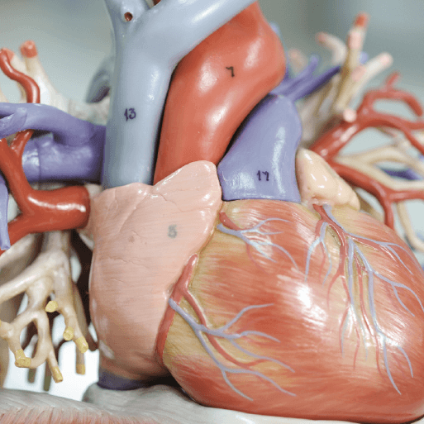
Topic Title: Blood Heart
Science:
We will focus on:
Heart dissection
Parts of the circulatory system
Scatter graphs
Components of blood
ABO blood groups
Blood flow
Animations
Acceleration and deceleration
Unhealthy substances
Fact files
The future
Design and Technology:
We will focus on:
Stethoscopes
Heart-healthy foods
Large-scale models
Art and Design:
We will focus on:
Modelling the heart
Blood red artwork

Slide 7
Topic Title: Key Topic Vocabulary for Blood Heart
Key Topic Vocabulary
Antibody
Aorta
Artery
Bacteria
Balanced diet
Blood
Blood donation
Blood group
Bloodstream
Blood transfusion
Blood vessel
Carbon dioxide
Chamber
Chemical
Key Topic Vocabulary
Chest cavity
Cigarette
Circulation
Circulatory system
Deoxygenated
Disease
Exercise
Fungi
Haemoglobin
Heart
Heart disease
Hormone
Immunity
Karl Landsteiner
Key Topic Vocabulary
Left atrium
Left Ventricle
Lungs
Muscle
Nutrient
Organ
Oxygen
Oxygenated Parasite
Plasma
Platelet
Protein
Pulmonary artery
Pulmonary vein
Pulse
Key Topic Vocabulary
Red blood cell
Rhesus negative
Rhesus positive
Right atrium
Right ventricle
Scientist
Smoking
Tissue
Vein
Vena cava
Virus
Waste product
White blood cell
William Harvey

