Slide 1
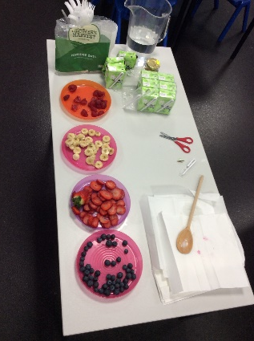
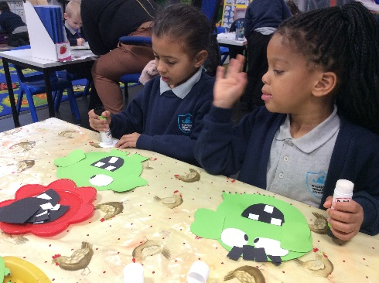
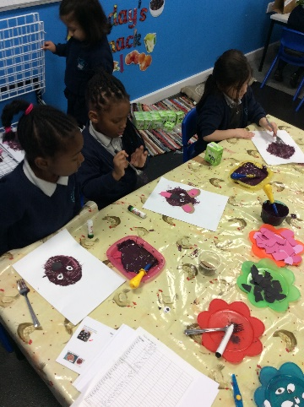
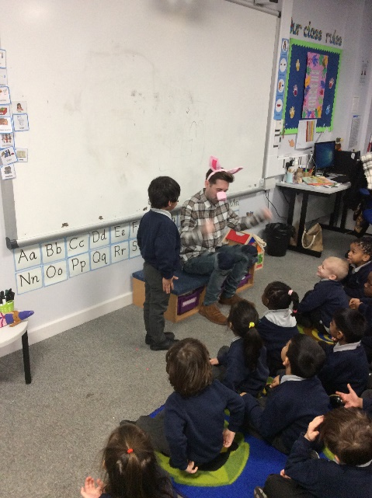
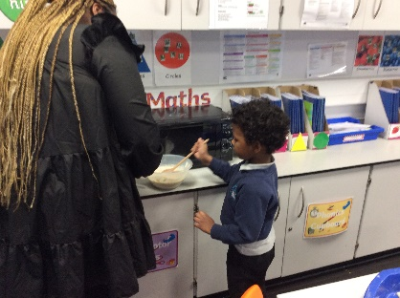
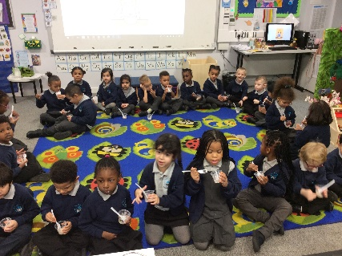
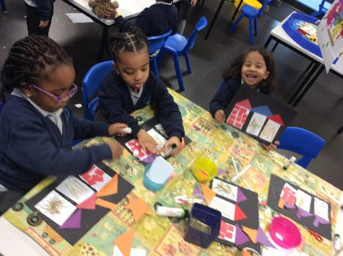
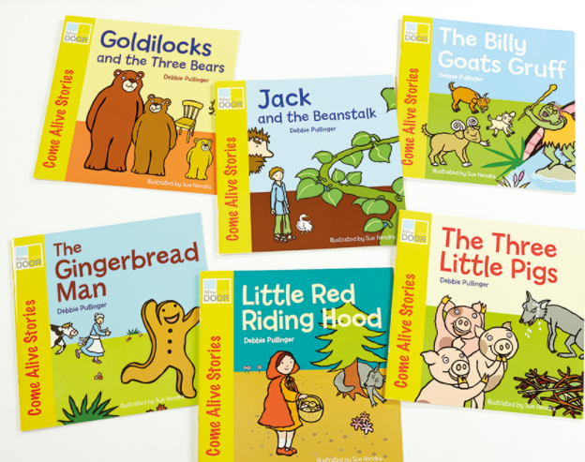
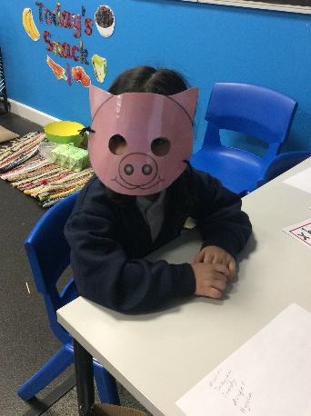
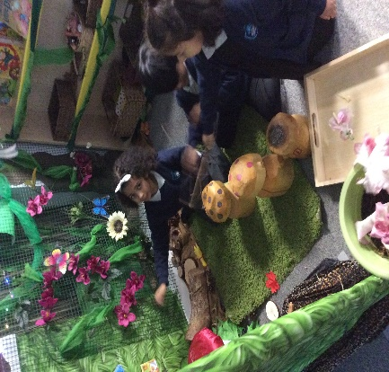
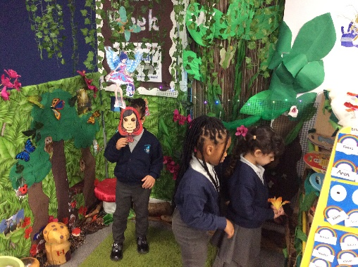
Duck Class!
January
For our Wow Launch, we had a special visit from a brave Pig who built his house made of Bricks from the story ‘The Three Little Pigs’. We asked him lots of questions from the story.
We even learnt how to make a healthy porridge like the bears in ‘Goldilocks and the three bear’ and it was just right!.
We have been making and creating characters and features from our traditional tales.
We enjoyed playing in ‘The Enchanted Forest’ with our friend whilst pretending to be some of the fairy-tale characters.
Take a look at some of the stories we have learnt thus far.

