Slide 1
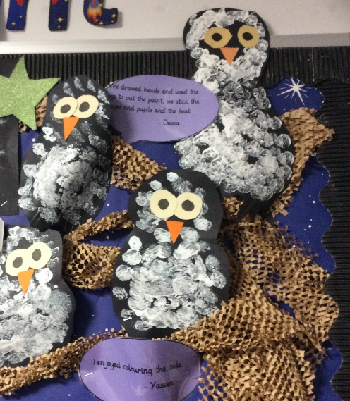
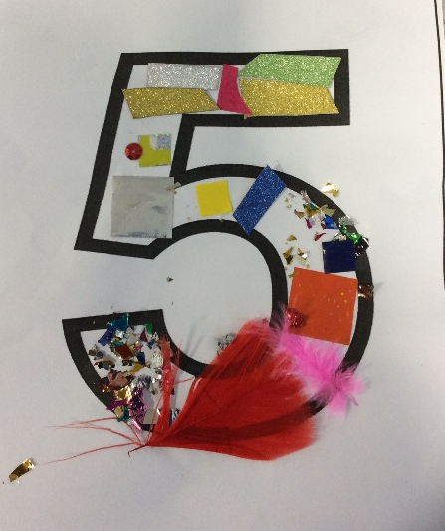
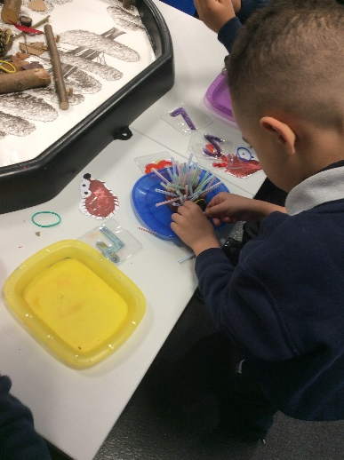
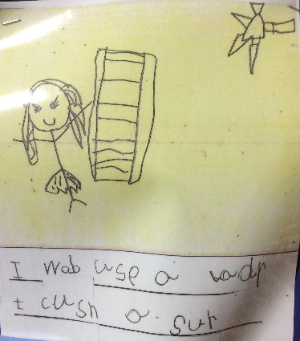
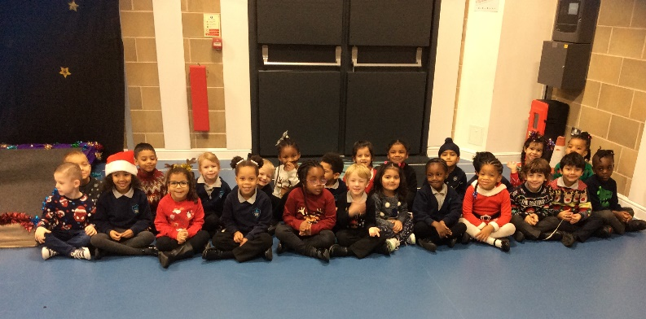
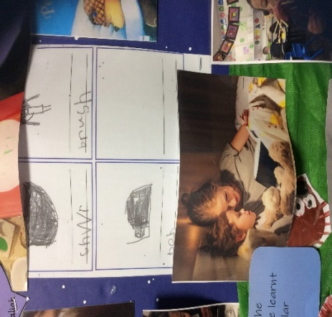
Duck Class!
December
We have learnt lots about nocturnal animals. We can name some nocturnal animals and even tell you some facts!
We have been using our Set 1 sounds to helps us form sentence in Literacy.
We have been learning our numbers up to 5.
We also have been having a go at writing our names independently.
The teachers at Duck class would like to wish you all a Merry Christmas and a Happy New Year!
We look forward to seeing you again in 2022!
We spoke lots about our bed time routine and compared how our routines are the same and different to each others.
We have worked really hard practising for the EYFS and KS1 Nativity!

