Slide 1
Riverside Primary School
Year 4 Curriculum Map
Autumn 2 - 2021

Slide 2
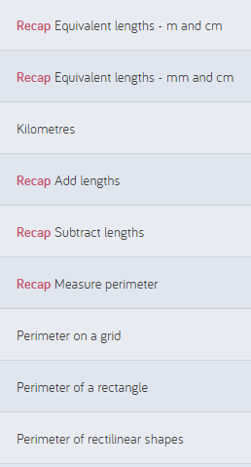
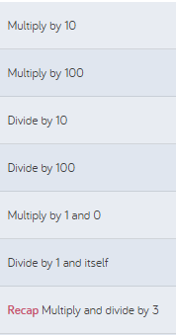
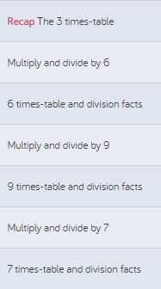
Topic Title: Maths
Maths:
We will focus on: Measurement and Perimeter, Multiplication and Division
Small steps taken from White rose

Slide 3
Topic Title: Literacy
Writing:
We will focus on:
Writing a diary extract as a Celtic Soldier
Writing a Newspaper report for the 10th Gladiatorial Games
A letter from a Roman Soldier
Conjunctions
Fronted adverbials
Pronouns
Extended noun phrases
Determiners
Colons and semi-colons
Prepositions
Adverbs
Guided reading:
We will be reading:
Hearing and Sound
The Bear and the Piano
My first Classical music book
Poems to perform
Charlotte’s Web
Spelling rule: (KS2)
We will focus on:

Slide 4
Topic Title:
PSHE:
We are learning:
How to avoid judging by appearances
Understanding the things that influence us
Understanding what bullying is and what to do about it
How to problem-solve
What make us special and how we can celebrate this
Music:
We are learning:
Playing the trombones
Assembling the trombone
Listening to other instruments and learning how to play as an ensemble
Learning to read musical notes
Learning to follow instructions from a conductor
R.E
We are learning:
What identity is and how it is expressed
Understanding what diversity means
How identity is shaped by our environment
What is means to be a global community

Slide 5
Topic Title:
P.E:
We are learning
Diwali Dance:
Creating and linking dance phrases using simple structures
To improvise freely using dance
To improvise dances with a partner
To develop awareness of rhythm, dynamics and expression
Computing:
We are learning:
Design, write and debug programs.
Use sequencing, selection and repletion in programs
Use logical reasoning to explain how simple algorithms work
Understand computer networks
Use a variety of software to design and create a range of programs, systems and content.

Slide 6
Topic Title: Wider curriculum.
History:
We will focus on:
Sequence events on a historical timeline
To know how Roman money was used
To describe Celtic settlements
Science:
We will focus on:
Sound and decibels
How sound is made
Comparing patterns and pitch
How sound travels to our ears
How sound changes at different distances
Electricity and circuits
Art and design.
We will focus on:
Designing a Roman coin
Using clay to create a 3D form
Designing a Roman sheild
Geography.
We will focus on:

Slide 7
Topic Title: Key Topic vocabulary
Key Topic Vocabulary
Amphitheatre
Aqueduct
Barbarian
Britannia
Celts
Emperor
Centurion
Coliseum
Gladiator
Chariot
Gaul
Gladious
Cassis
Key Topic Vocabulary
Invader
Latin
Legion
Mosaic
Pilum
Empire
Numerals
Scuntum
Servus
Taxes
Standard
Soliloquy
Pugio

