Slide 1
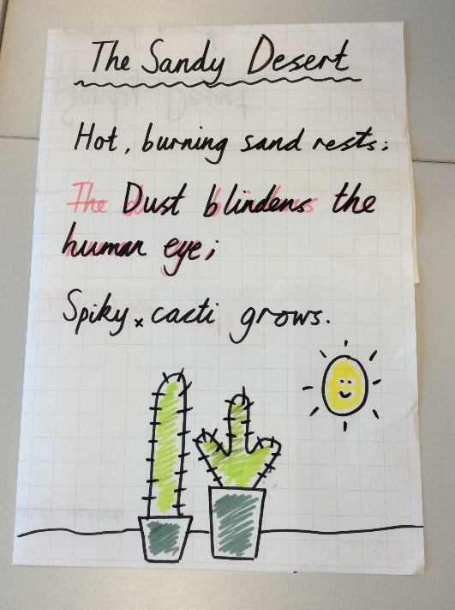
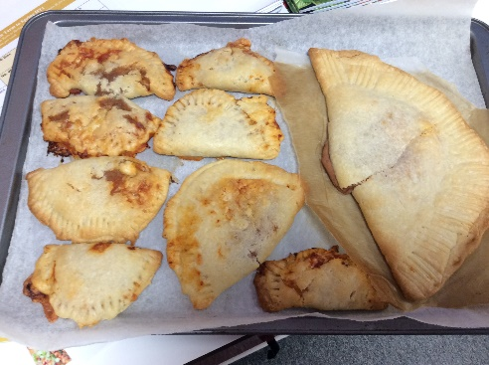
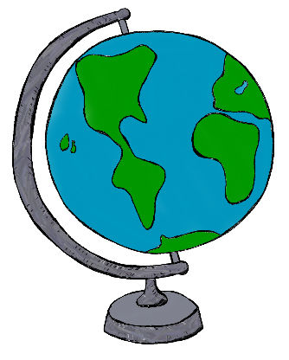
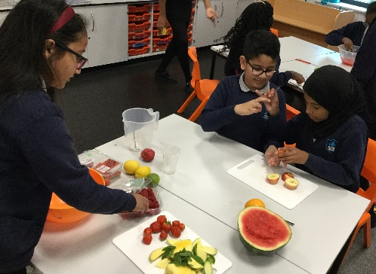
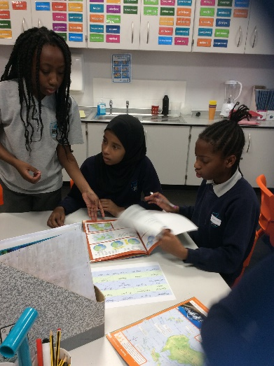
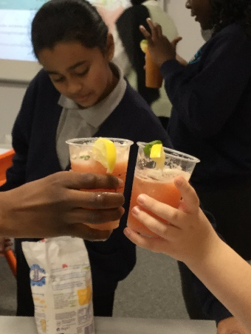
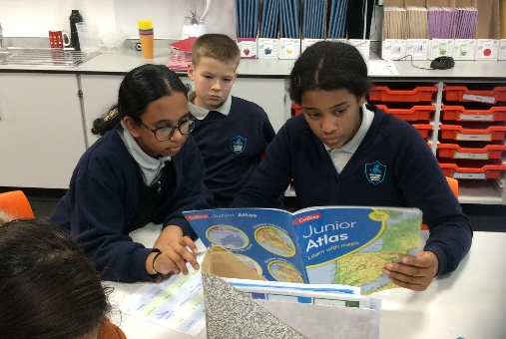
In Literacy, we have been focusing on writing a Haiku poem. In groups we wrote our own Haiku poems about different climates and places
This half term, our topic is Hola Mexico. As a class, we made a variety of Mexican dishes and we planned and made our own fruit punch.
We had Geography Day in school where we competed in a game of bingo. We worked as a team and used atlases to help us find our answers.
This month was also Children in Need, so we dressed up in our comfiest pyjamas to raise money.
November

